Slide 1
Predicting the ideal restaurant location in Toronto
Applied Data Science Capstone
IBM Data Science Professional Certification
Briana Brown

Slide 2
Problem
Being that Toronto has a very lucrative and ever-growing tourism industry, owning a restaurant has the potential to be a very lucrative business if it is placed in a prime location.
The factors for a restaurant’s success include the amount of spending power/ foot traffic, lowest crime rate, and least amount of competition.
Business Problem: If the client wanted to open up a restaurant in Toronto, which area is the best option in which to open a restaurant?

Slide 3
Data
Data Sources
Foursquare API
Toronto Census
Toronto Police Maps Crime Data
Population of Each Neighborhood (Toronto Census)
Income Distribution of Each Neighborhood (Toronto Census)
Homicide Average of Each Neighborhood (Toronto Police Maps Crime Data)
Number of Restaurants in Each Neighborhood (Foursquare API)
Latitude and Longitude of Each Neighborhood

Slide 4
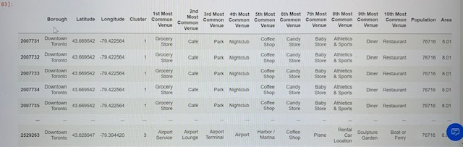
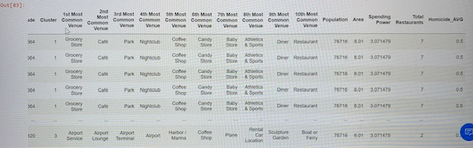

Slide 5
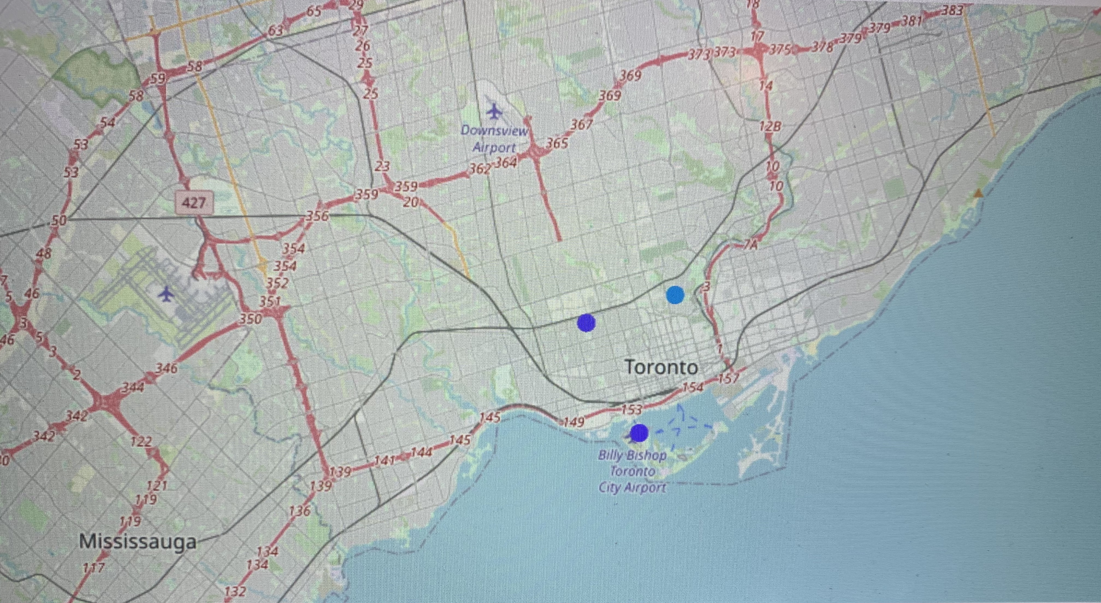
Light Blue
Purple
Cluster 1 = Purple
Cluster 2 = Light Blue

Slide 6
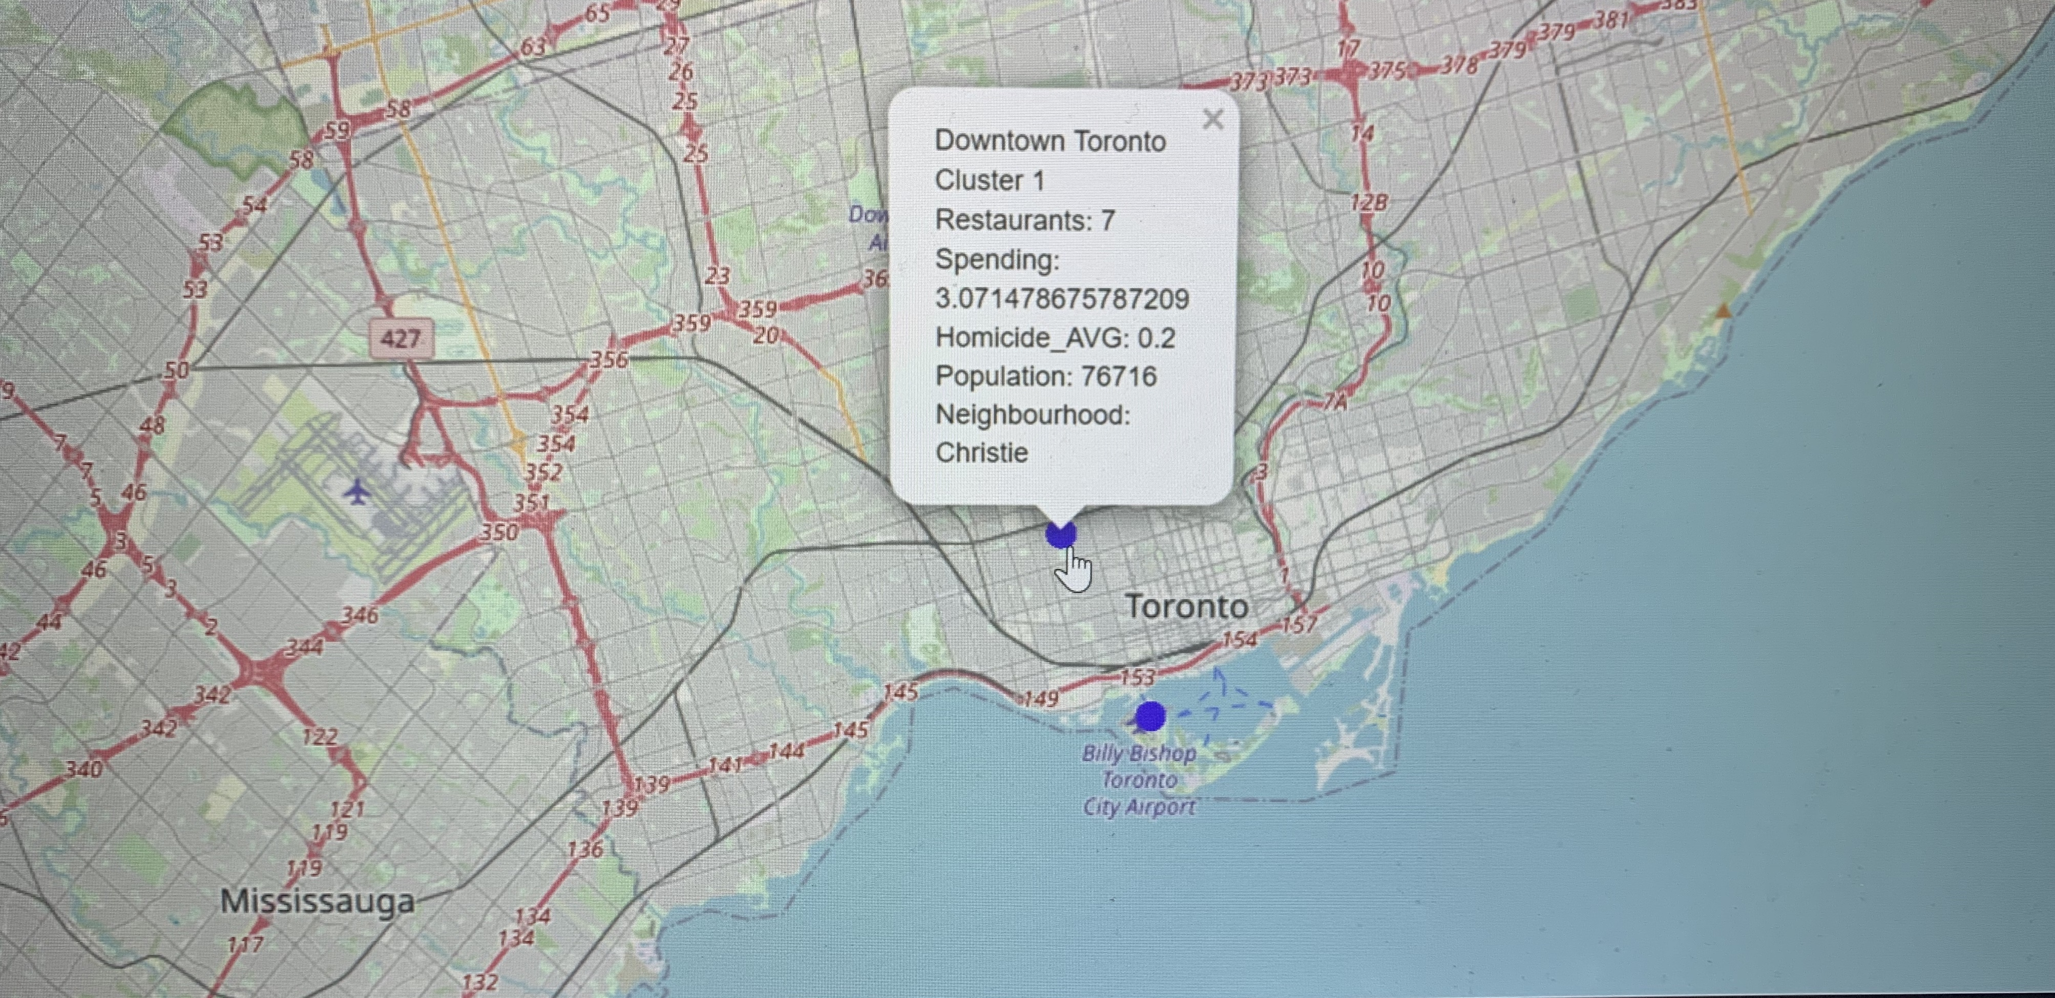

Slide 7
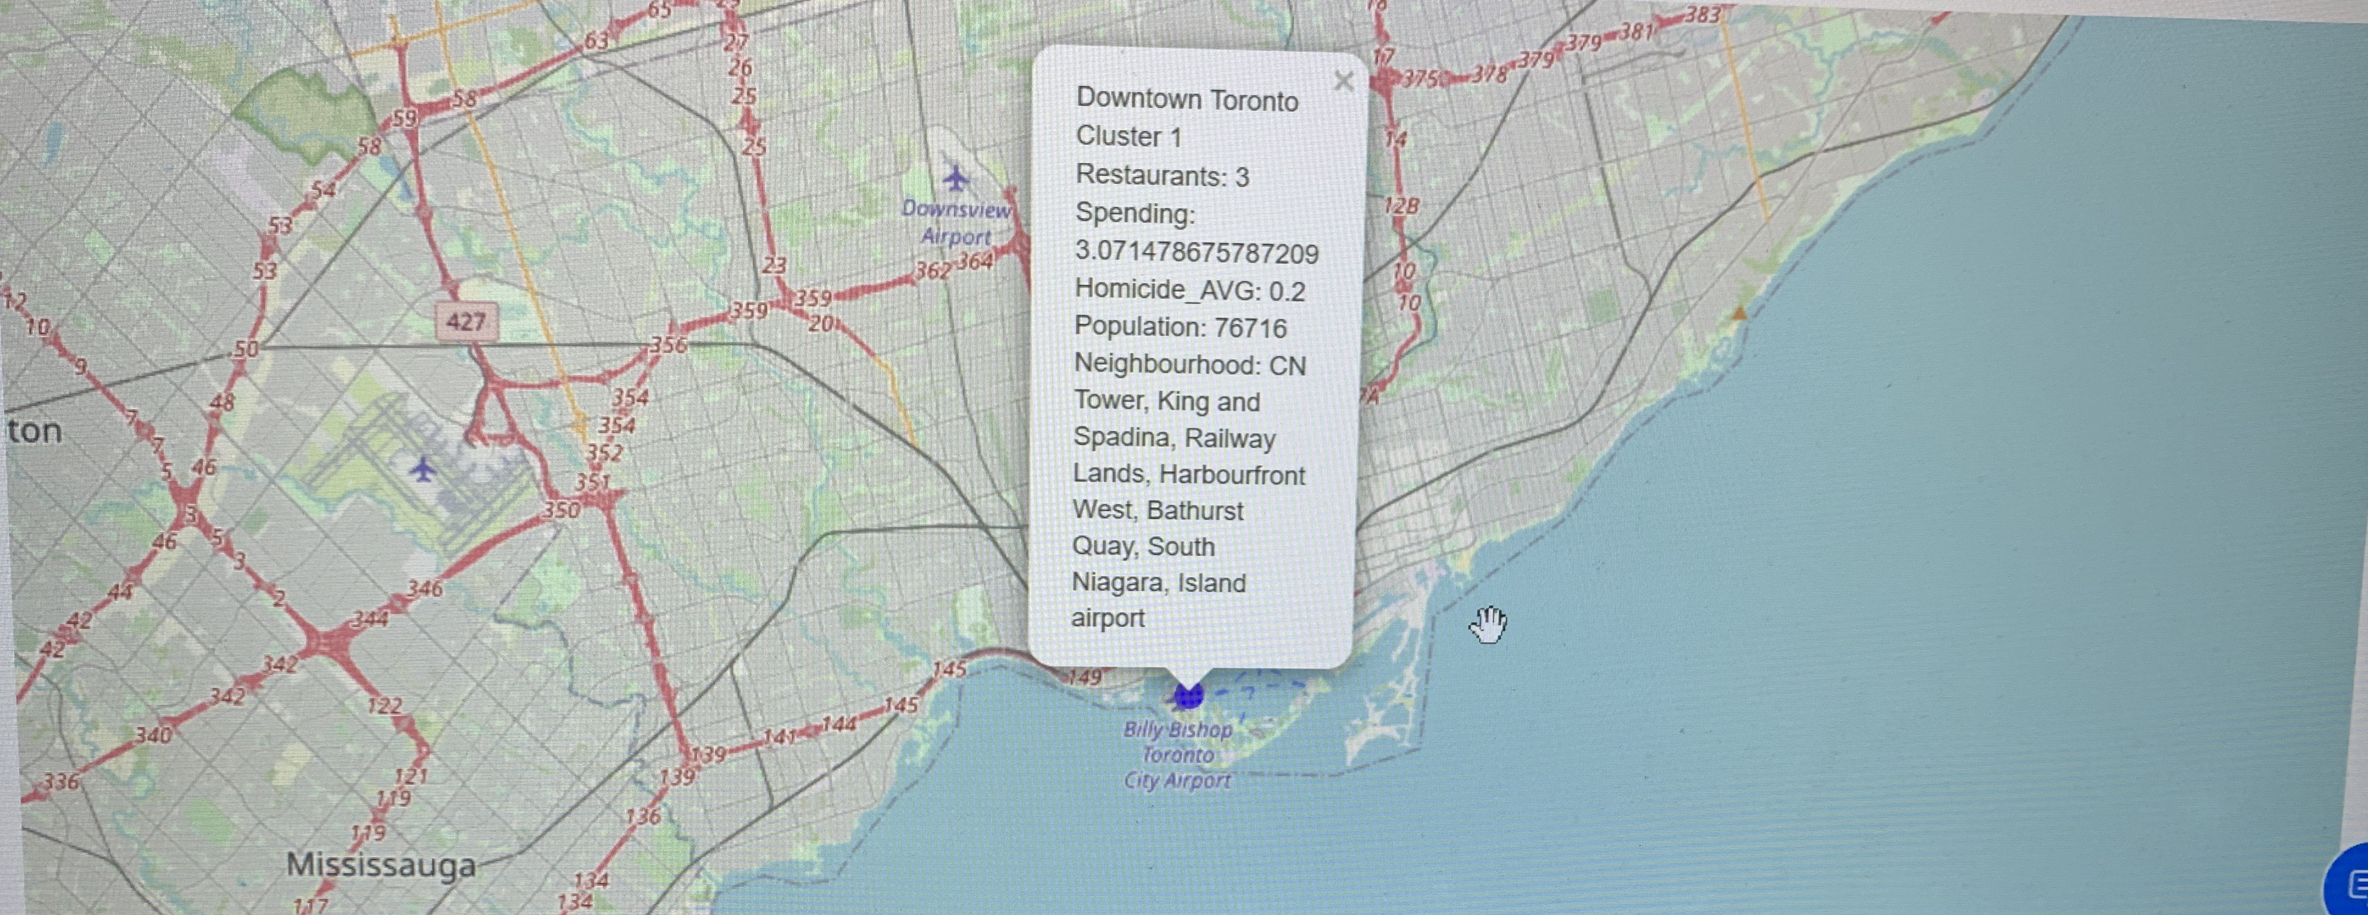

Slide 8
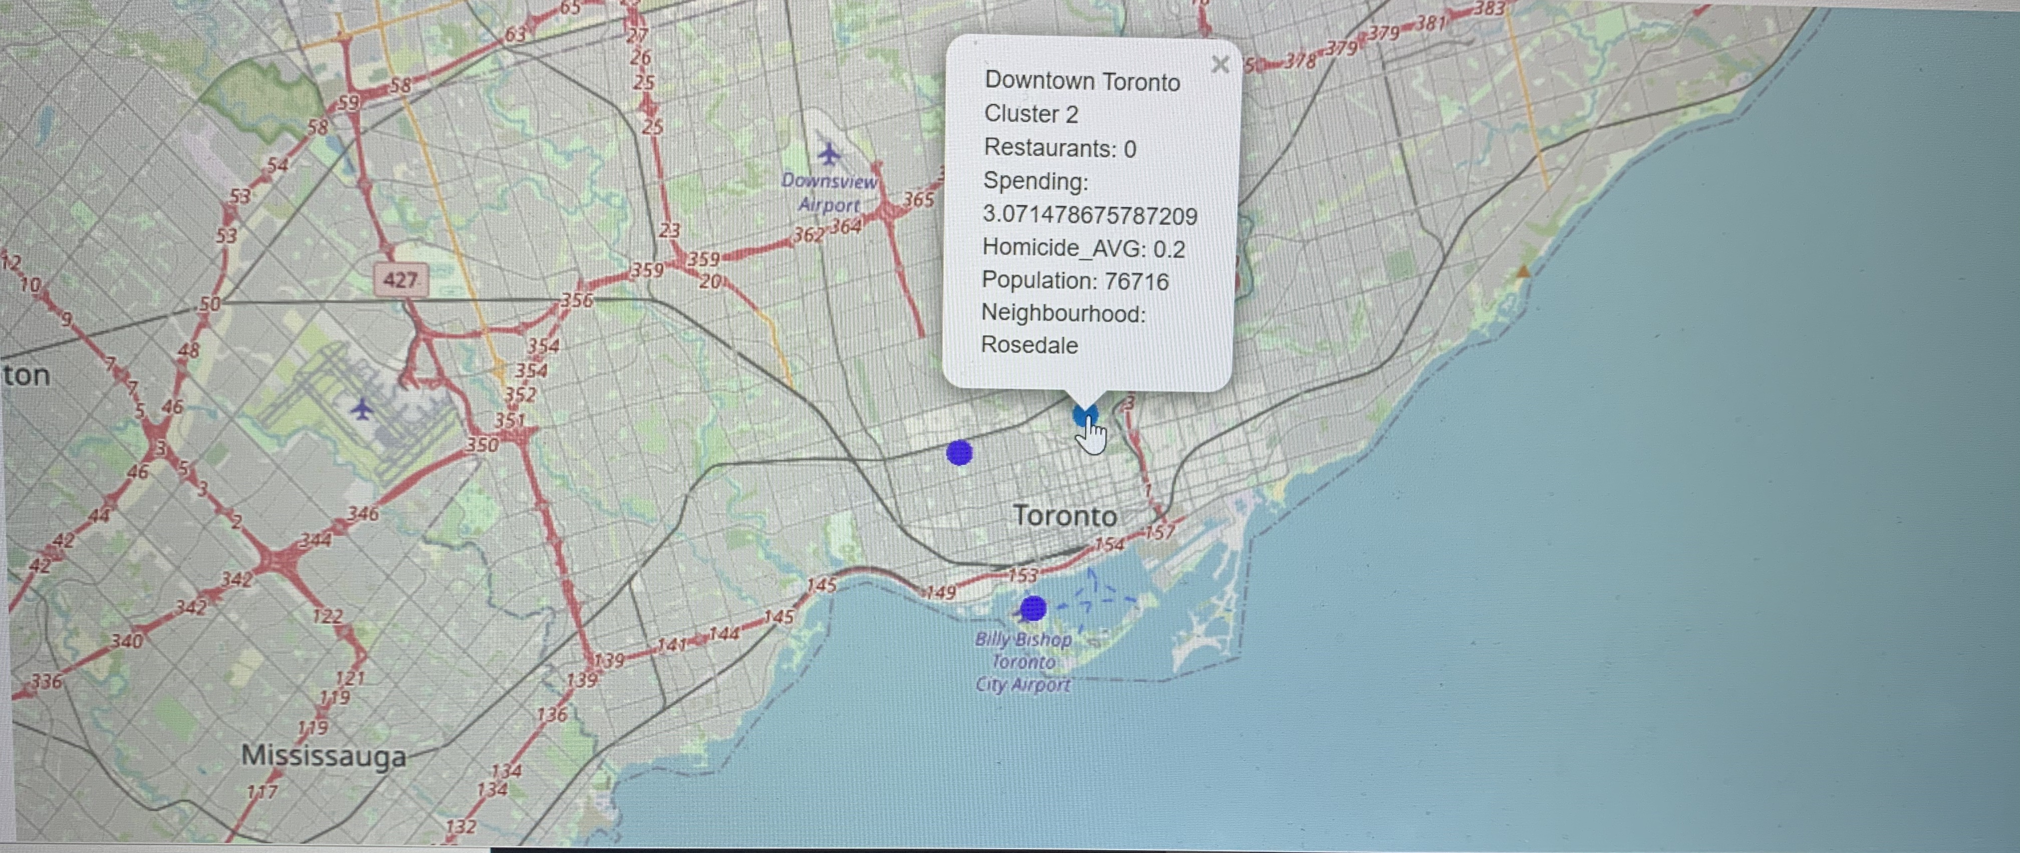

Slide 9
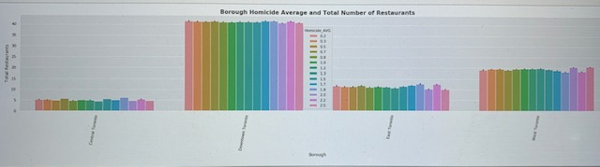
From the plot we can see that the borough with the highest number of restaurants and spending power is Downtown Toronto. Therefore, all other boroughs can be filtered out because they do not have nearly as much foot traffic/ profit potential as Downtown Toronto.

Slide 10
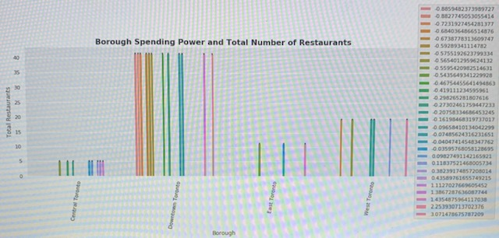

Slide 11
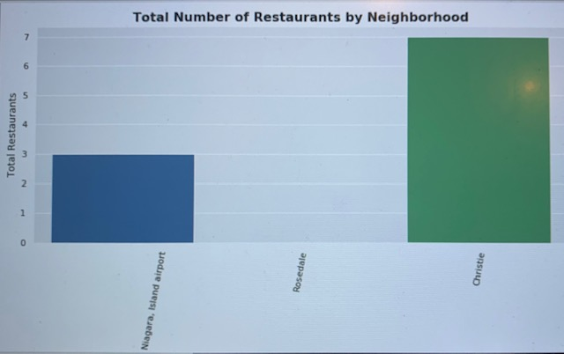

Slide 12
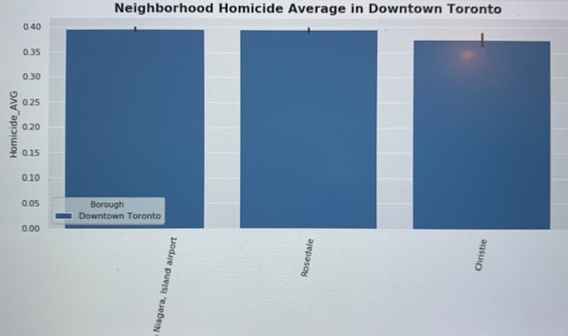

Slide 13
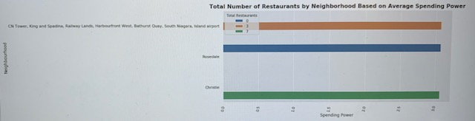
The neighborhood with the highest spending power paired with the lowest number of restaurants is the neighborhood of Rosedale therefore with rising tourism, the demand for restaurant food in this area will be the greatest compared to the neighborhoods of South Niagara and Christie.

Slide 14
Conclusion
The ideal location in which to open a restaurant is the neighborhood of Rosedale in Downtown Toronto.

